Slide 1
Forecasting resource demand using time series

Slide 2
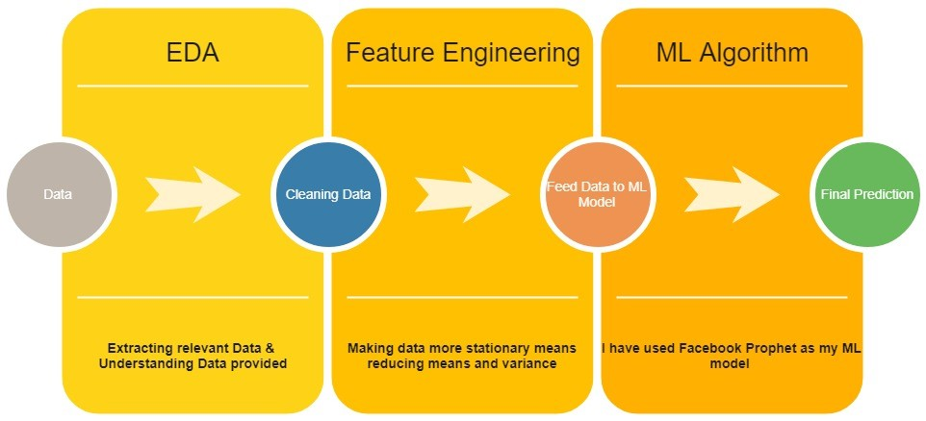
Process of Machine Learning

Slide 3

Pre-processing steps taken
I have only considered Head count data whose status is “Billable” which represents actual demand
Second sheet mentions “Demand trend last year” which if I understood it correctly it shows the trend and not the actual demand so I have not used in my model.
Forecasting has been done at single technology at a time and not group of technologies.
Tuning Parameters are provided to forecast data at different level (location/technology/designation)
Log transformation is used to make data more stationary
Fb prophet has been used as forecasting tool
Only data after year 2010 has been considered.

Slide 4
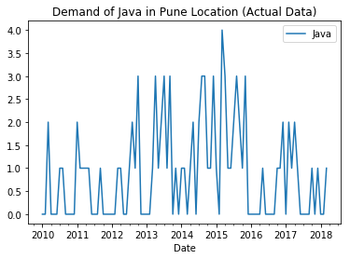
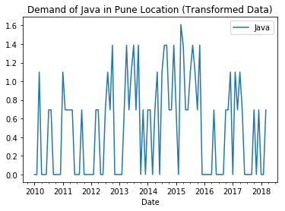
Log Transformation is used to make data more stationary

Slide 5
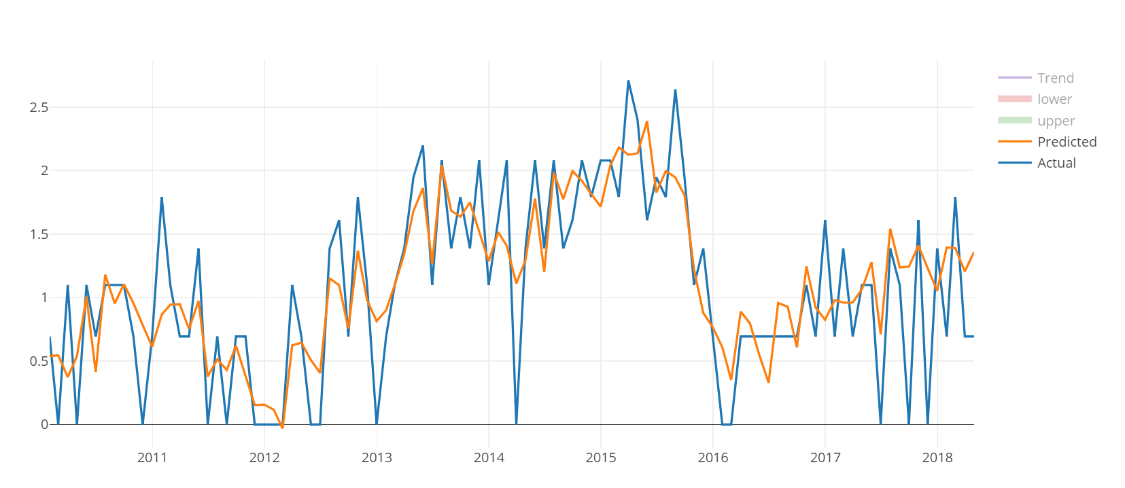
Demand of java in Pune
RMSE (calculated on last 12 months data) : 1.4142

Slide 6
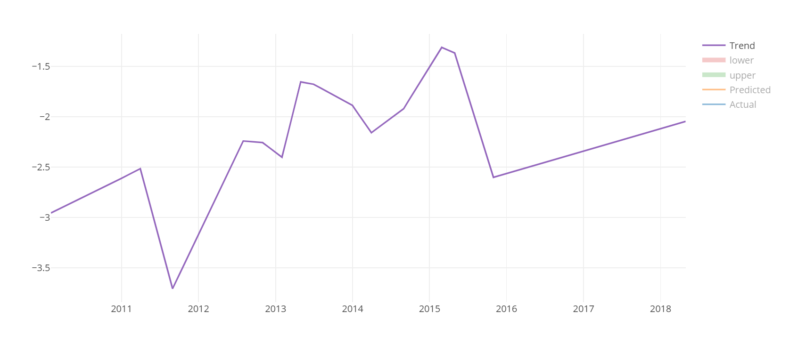
Trend Component
We can observe from the above graph that demand for java is on rise after a dip in 2016 for Pune location.
Note: Legal dispute between Oracle & Google intensified in 2015-16 period. On May 26, 2016, the district court decided in favor of Google. Source: Wikipedia

Slide 7
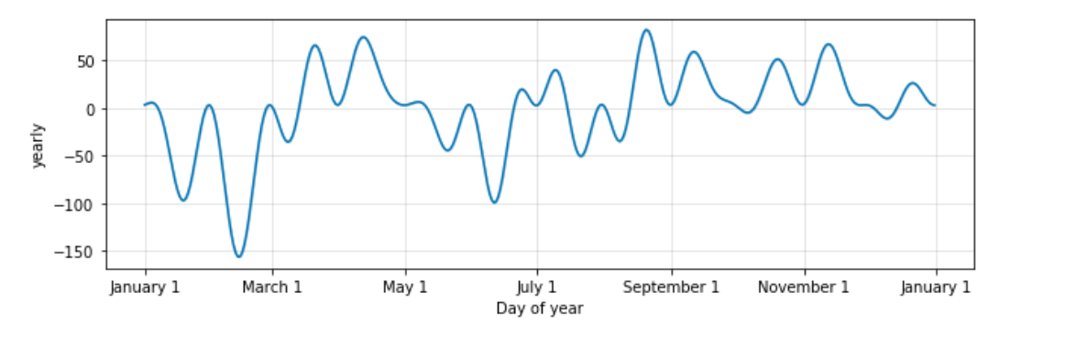
Seasonal Component
For above graph it is evident that demand of resource is at his peak after march and September which is financial year end for India and US respectively

Slide 8
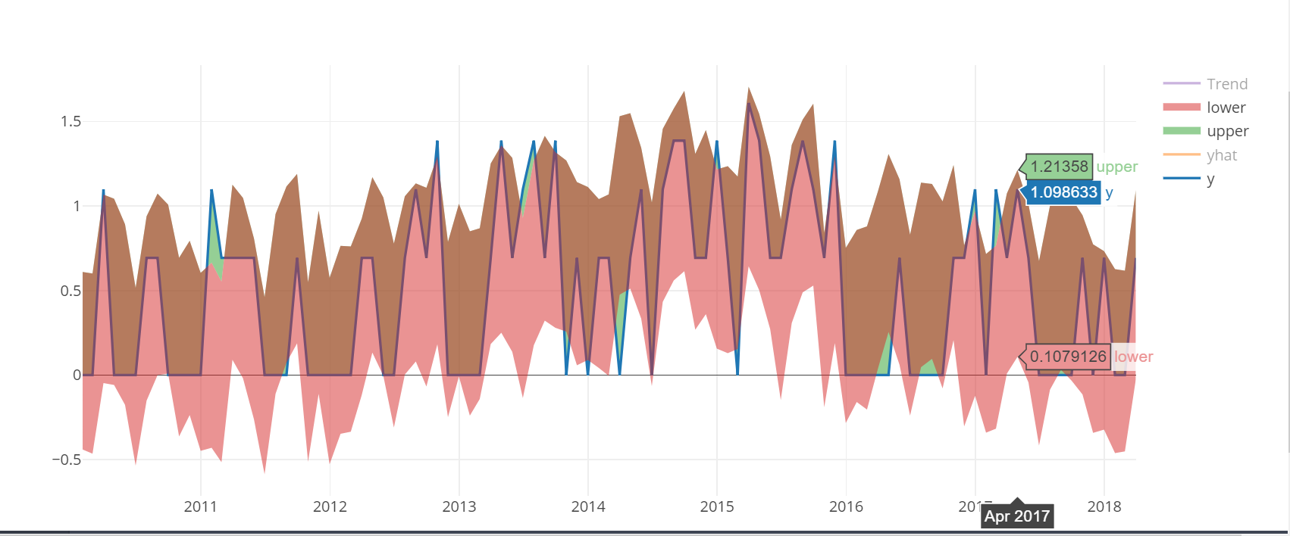
uncertainty intervals
We can predict upper and lower limit. The width of the uncertainty intervals (by default 80%) can be set using the parameter interval width

Slide 9
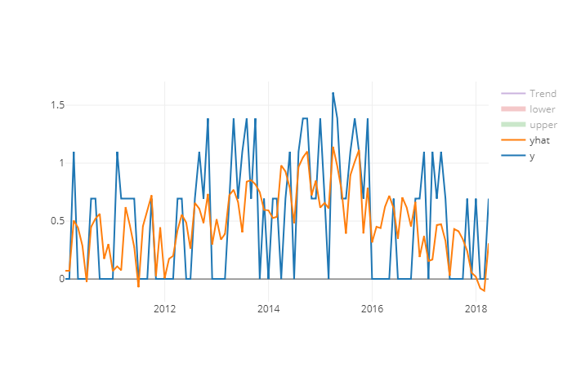
Demand of java consultant in Pune
MSE (calculated on last 12 months data) : 0.5384
Note: MSE is used in this case to penalize outliers

Slide 10
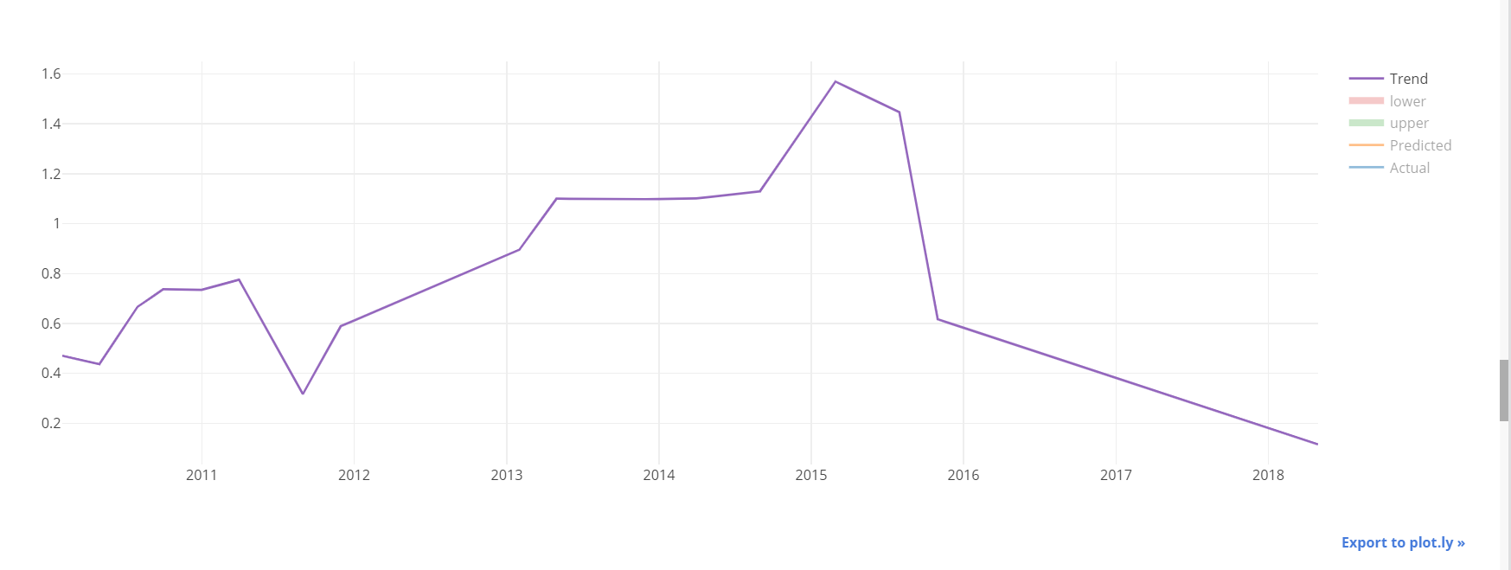
Trend of Manual Testing across all locations
Demand for Manual testing is all time low which makes sense as Automation is taking over from Manual testing.

Slide 11
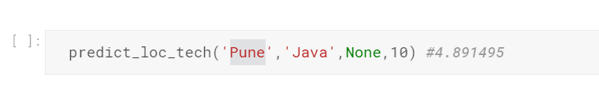
How to validate code
Run the code as it is
Define parameters for which you want to predict such as Location, Technology, Designation
If you want to predict demand of Java for Pune location. You can define designation parameter as ‘None’. Last parameter is hyper parameter which needs to be tuned for different data set.
Program will show you the RMSE for last 12 months. It will also show you the prediction plot with trend and seasonality.

Slide 12
Demo

Slide 13
Business case
Resource manager of specific location will forecast resource requirement for each technology
Whenever they hire a resource with multiple skills demand from each technology will reduce. For ex. If a resource is hired with skills of Java and SQL then demand from each of the technology for that location reduces by 1
We can use other methods to identify which group of technologies works together as best from last year data.

Slide 14
Advantage of using Prophet
Prophet is tool released by Facebook research team
It produced good result with at least few months (preferably a year) of history
Can handle a reasonable number of missing observations or large outliers
Performs better when trends that are non-linear growth curves, where a trend hits a natural limit or saturates
Can identify historical trend changes.
Strong multiple “human-scale” seasonality : day of week and time of year
If the forecast is not satisfactory — an analyst with no training in time series methods can improve or tweak forecasts using a variety of easily-interpretable parameters

Slide 15
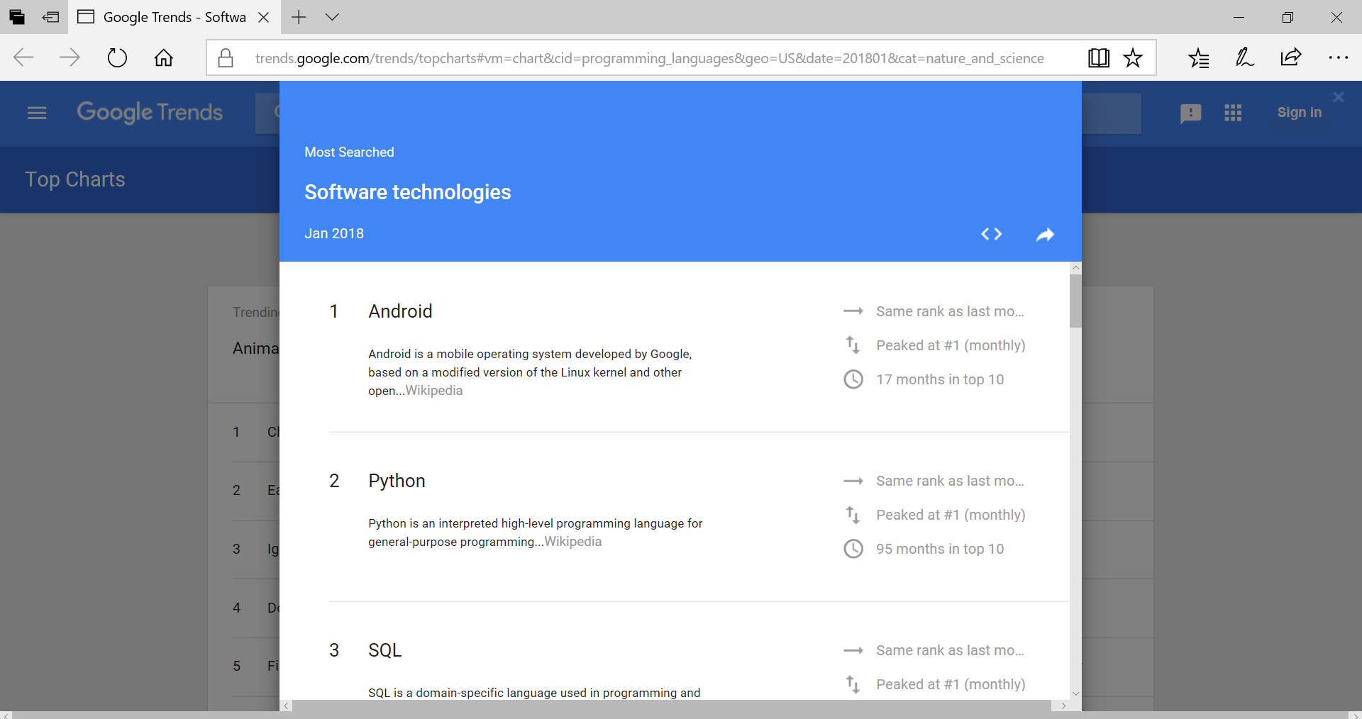
External Data (If allowed)
We can use GDP data of all the countries which will affect the demand.
If an organization has more footprint in Europe then GDP data of Europe and India should be considered.
Google Trend data can be used to get more accurate results & also future demand.
Google Trend

Slide 16

Thank You

